Slide 1
SURPLUS SERVE
Done By:
Lana Anvar,
Ashfaq Hussain M S

Slide 2

AGENDA
Introduction
Functionalities
Wire Frame
Tech Stack
AWS

Slide 3
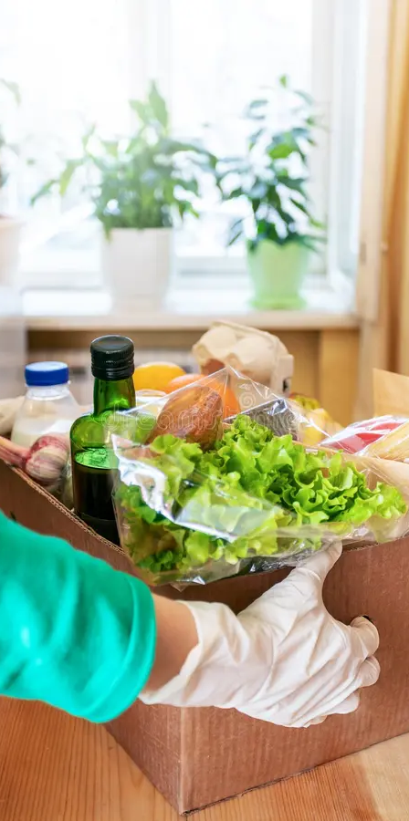
INTRODUCTION
Food wastage is a significant global issue, with millions of tons of perfectly edible food going to waste every year, while countless individuals and families face food insecurity.
Our web app, SURPLUS SERVE, is designed to bridge this gap by acting as an intermediary between restaurants and charitable organizations or people in need.
By offering surplus food at half the price, our platform ensures that less food is wasted, while also providing an affordable, nutritious option for those in need.

Slide 4
FUNCTIONALITIES
1. User Roles and Registration
2. Dashboard for Donors and Recipients
3. Food Donation Management
4. Food Request Management
5. Payment Processing
6. Analytics and Reporting
7. Communication and Notifications
8. Map Integration
9. Admin Panel
10. Feedback System

Slide 5
WIRE FRAME

Slide 6

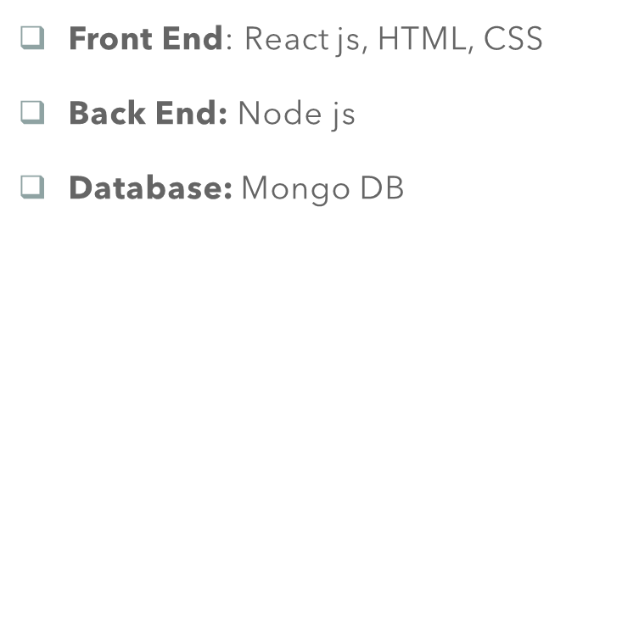
TECH STACK

Slide 7
AWS REQUIREMENTS
AWS Lambda: Allows you to run your Node.js backend.
Amazon API Gateway: Expose your Lambda functions as RESTful APIs that your front end can interact with.
MongoDB Atlas (External Service): A cloud-hosted MongoDB is easier to manage and scalable.

Slide 8
THANK YOU

